Slide 1


Ilyas F Principle Cloud Consultant- Xpirit
Accelerate Agile development with
imohammed@xpirit.com || @ilyas_tweets

Slide 2
Understanding the principles of Agile and Cloud Learn the current challenges involved with the development Understand the flavors of cloud Cloud Tooling Customer Case Study 1 Customer Case Study 2 Our Learning Key Takeaways
Agenda

Slide 3
Lets understand the buzz words …Agile / DevOps / Cloud
Agile
is a set of principles for software development under which requirements and solutions evolve through the collaborative effort of self-organizing cross-functional teams.
Devops
is a combination development and operations that emphasizes the collaboration and communication of both software developers and other information-technology (IT) professionals and automate the process of software delivery and infrastructure changes
Cloud
is an Internet-based computing that provides shared computer processing resources and data to computers and other devices on demand.

Slide 4



Lifecycle of Agile S/W Development
Deploy
Deploy
Deploy
Deploy
Deploy
Deploy
Deploy
Deploy
Code
Build &
Package
Provision
Deploy
Test
Prod Deploy

Slide 5
Challenges for AGILE Developers
Obtaining Infrastructure takes longer time
Integration of Infrastructure with the Development Environments
Automation of repeated tasks such as infra provisioning
Performance Testing in variety of Environments/User Load/Browsers
Managing multiple environments like Staging /Testing and Production is tough
Experimentation with different Language and stack is difficult
Have to deal with different set of tools for complete Application Life cycle Management and Feedback
Team Collaboration & Agile /Scrum Project Management Tools
Automated Test/Build pipelines
Source Code Branching Strategies

Slide 6
Challenge : Obtaining Infrastructure

Slide 7
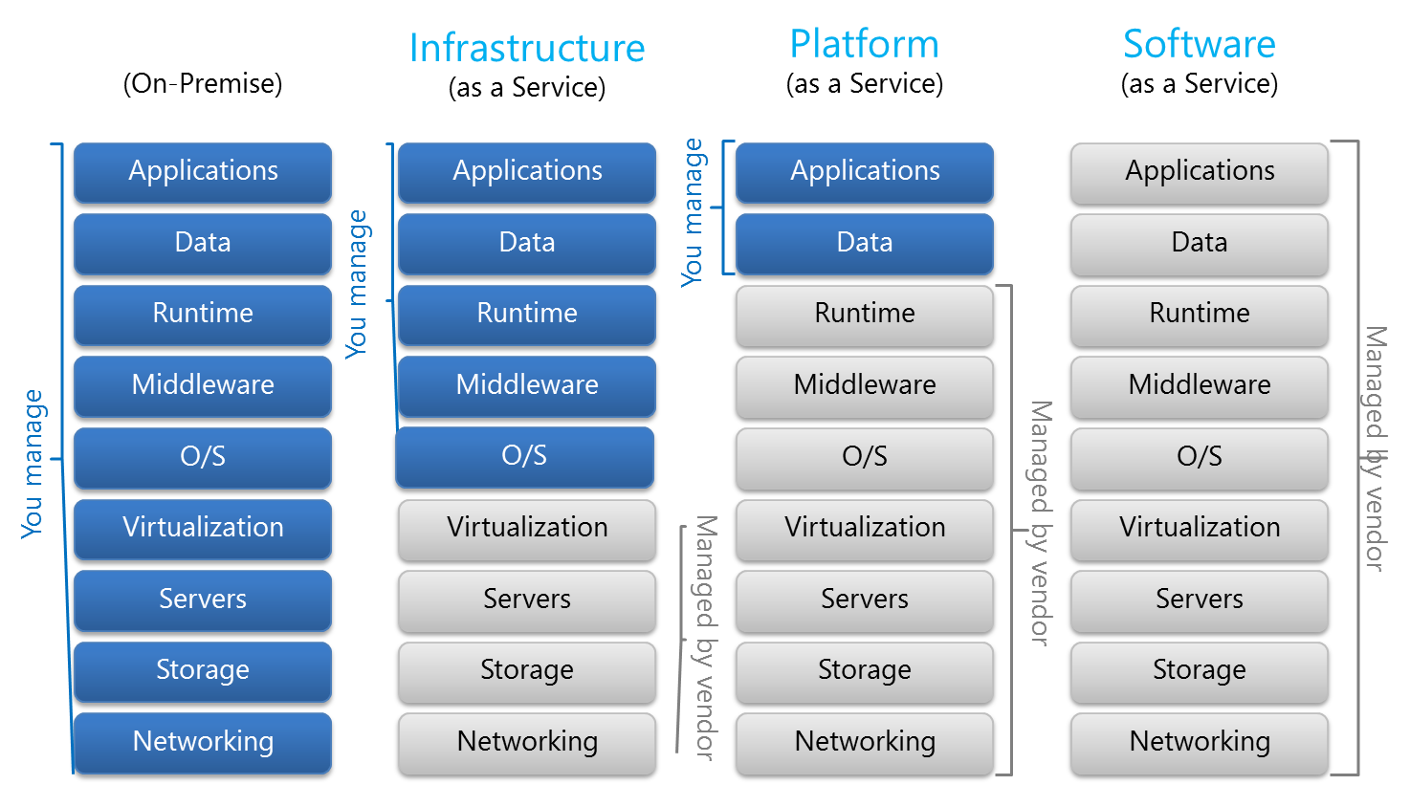
Cloud Models

Slide 8
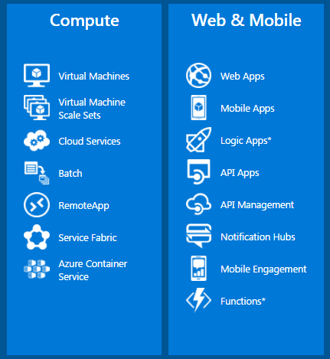
Compute Options

Slide 9
Azure Dev – Test

Slide 10
IaaS or PaaS – Choose Wisely
PaaS is mode Agile & developer friendly but possess certain restrictions
Azure PaaS Provides integration with CI/CD and developer environments and runtime
IaaS is less Agile & developer friendly
IaaS offers more flexibility but comes with overhead
There are price differences between IaaS & PaaS, however evaluate the benefits over price

Slide 11
Challenge : Dev Environment integration with Infra

Slide 12
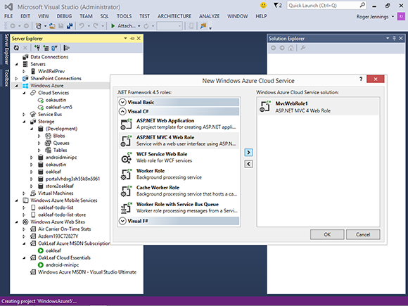
Native Integration with Dev IDE

Slide 13
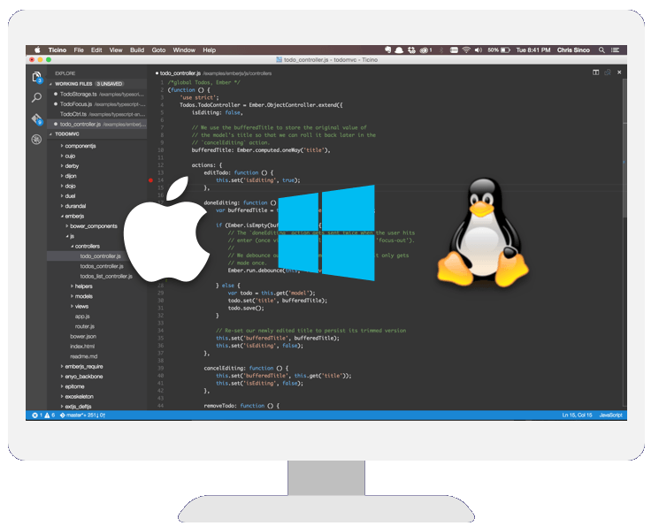
Visual Studio Code for Free/Cross Platform

Slide 14
Challenge : Automated Infra Provisioning

Slide 15
Infra as code – Azure Resource Manager
Template Driven
Declarative
Idempotent
Multi-Service
Multi-Region
Extensible

Slide 16
Azure Resource Manager
<Resource Group>
Name: foo RG
Data Center
<WebApp>
Name: foo.azurewebsites.net
Hostname: foo.azurewebsites.net
Kind: WebApp
AppServicePlan: fooPlan
<App Service Plan>
Name: fooPlan
Location: West Us
Size: Small
Instances: 1

Slide 17
Azure Resource Manager
<Resource Group>
Name: foo RG
Data Center
<WebApp>
Name: foo.azurewebsites.net
Hostname: foo.azurewebsites.net
Kind: WebApp
AppServicePlan: fooPlan
<App Service Plan>
Name: fooPlan
Location: West Us
Size: Small
Instances: 3

Slide 18
Azure Resource Manager
<Resource Group>
Name: foo RG
Data Center
<WebApp>
Name: foo.azurewebsites.net
Hostname: foo.azurewebsites.net
Kind: WebApp
AppServicePlan: fooPlan
<MobileApp>
Name: foo-mobile.azurewebsites.net
Hostname: foo-mobile.azurewebsites.net
Kind: MobileApp
AppServicePlan: fooPlan
<App Service Plan>
Name: fooPlan
Location: West Us
Size: Small
Instances: 3

Slide 19
Azure Resource Manager
<Resource Group>
Name: foo RG
Data Center
<WebApp>
Name: foo.azurewebsites.net
Hostname: foo.azurewebsites.net
Kind: WebApp
AppServicePlan: fooPlan
<MobileApp>
Name: foo-mobile.azurewebsites.net
Hostname: foo-mobile.azurewebsites.net
Kind: MobileApp
AppServicePlan: fooMobilePlan
<App Service Plan>
Name: fooPlan
Location: West Us
Size: Small
Instances: 3
<App Service Plan>
Name: fooMobilePlan
Location: West Us
Size: Small
Instances: 2

Slide 20
Show me the Code - Demo

Slide 21
Challenge 4 : App Testing in variety of Environments/User Load/Browsers

Slide 22

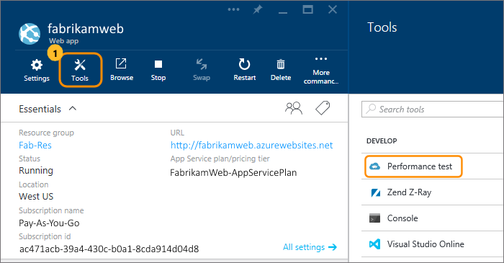
Performance Testing with Azure
Quick: Just one click performance lab in cloud, no setup needed.
Scale up or down based on your needs.
Free load testing: Get 20,000 virtual user minutes every month free
Real-time charts and graphs
Test where your users are: Test from different locations to reduce latency and simulate local conditions.
Get deeper insights about performance: Get full server and client diagnostics when you simulate real-life load patterns for your app.

Slide 23
Demo – Azure Load Testing

Slide 24
Challenge : Managing multiple environments like Staging /Testing and Production is tough

Slide 25
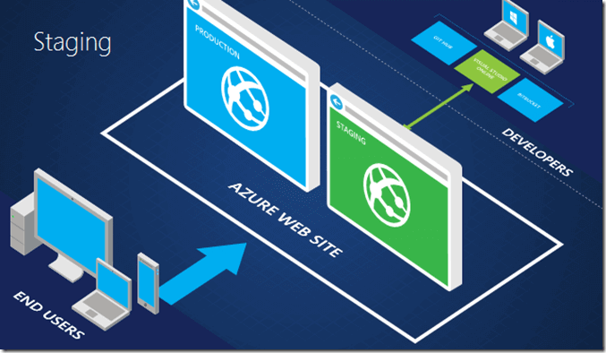
Staging/Testing Environments on Cloud

Slide 26
Demo – Azure Slots

Slide 27
Challenge : Experimentation with different Language and stack is difficult

Slide 28
Challenges : -Have to deal with different set of tools for complete Application Life cycle Management and Feedback -Team Collaboration & Agile /Scrum Project Management Tools -Automated Test/Build pipelines

Slide 29
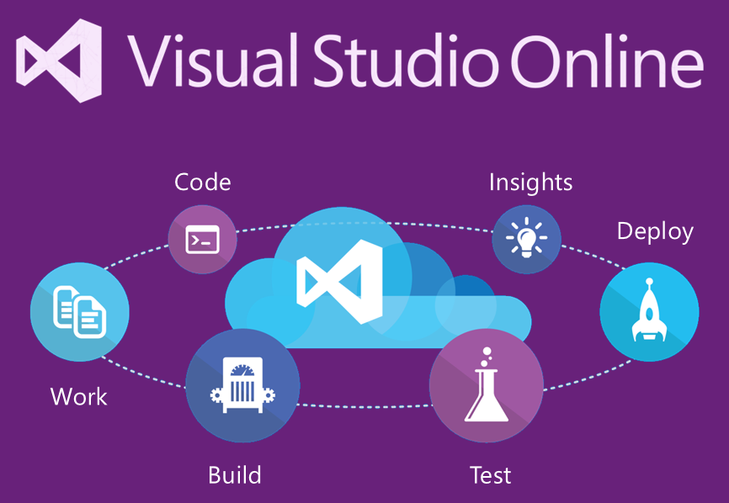
ALM with Visual studio Team Services

Slide 30
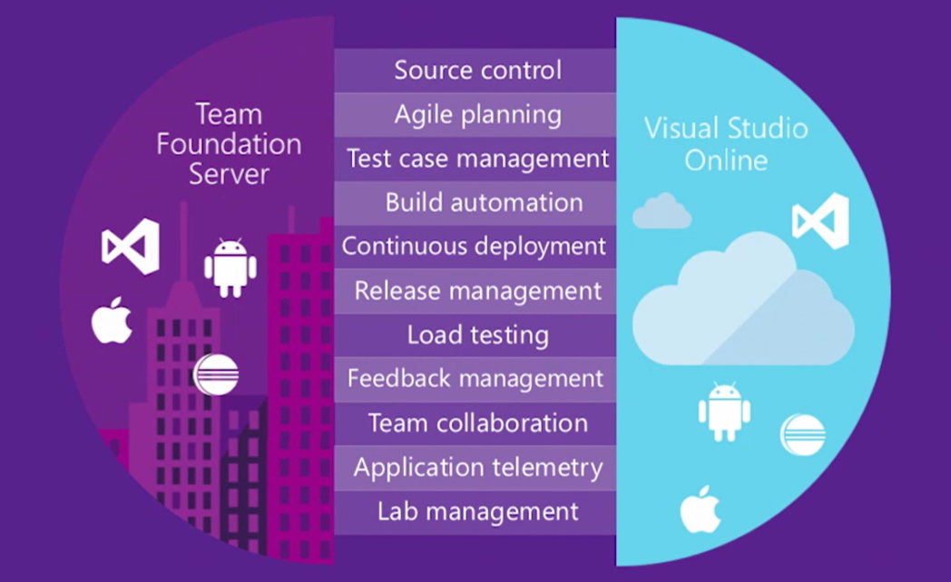
Features of Visual studio Team Services

Slide 31
Demo – Visual Studio Team Services

Slide 32
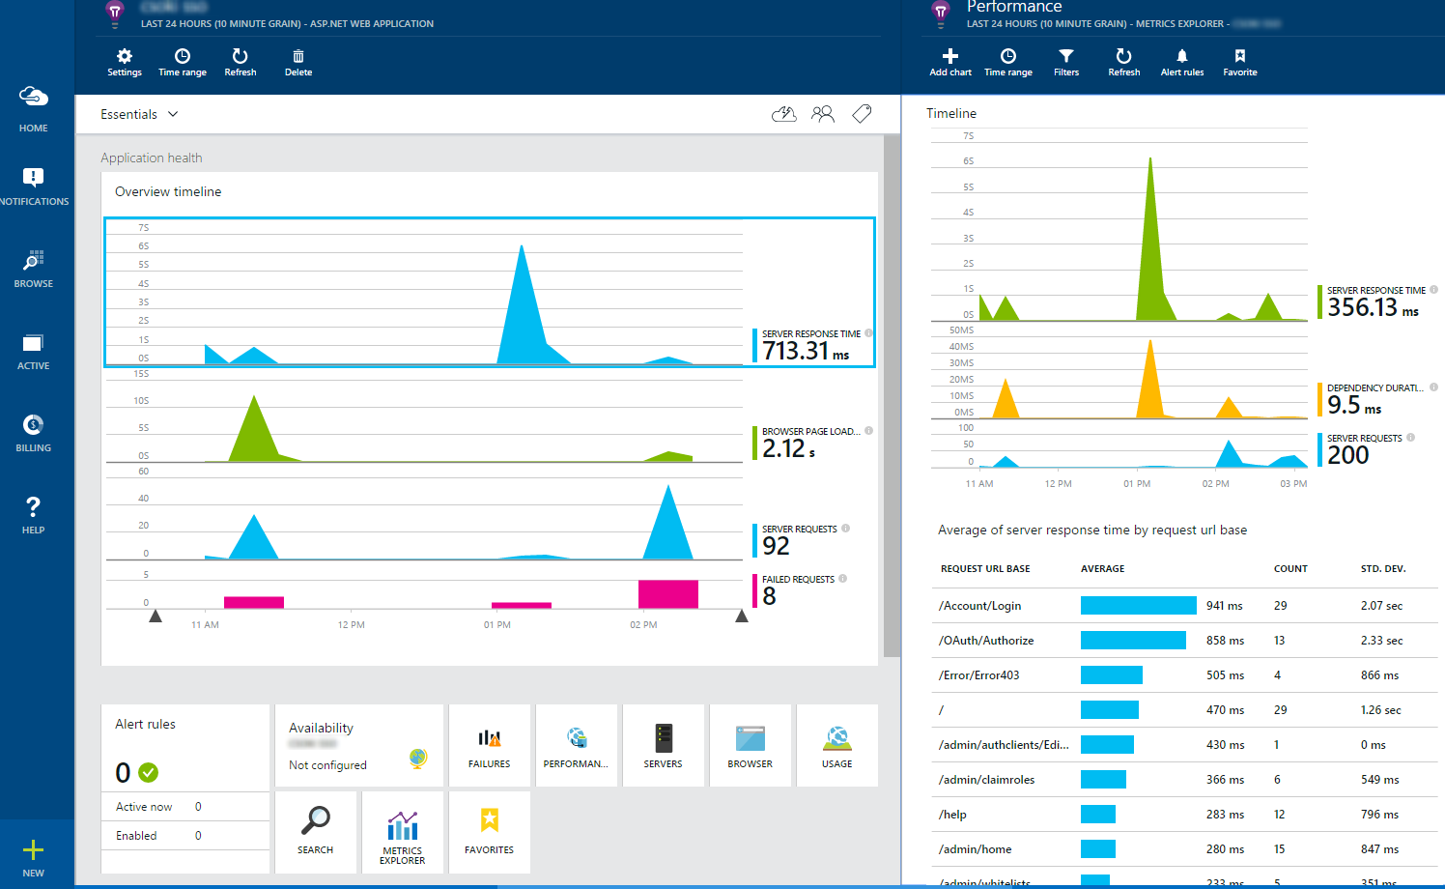
Application Insights
Application performance management
Interactive data analytics
Machine learning
Azure Diagnostics
DevOps integration
Easy to Get started

Slide 33
Challenge : Code Branching Strategies

Slide 34
Branching Strategy
N-2
N-1
Master
Test
Dev

Slide 35

App Service Architecture: Option1
<Resource Group>
Master
Test
Dev
bkRun
bkRun-Staging
bkRunTest
bkRunDev
bkRunPlan
bkRunPlanTest
bkRunPlanDev
bkRunDB
bkRunDB
bkRunDB

Slide 36
App Service Architecture: Option2
bkRunProdRG
bkRunTestRG
bkRunDevRG
Master
Test
Dev
bkRun
bkRun-Staging
bkRunTest
bkRunDev
bkRunPlan
bkRunPlanTest
bkRunPlanDev
bkRunDB
bkRunDB
bkRunDB

Slide 37
AgiLe Commandments
keep your code in a repository
automate the build / automate deployment
keep the build fast
make build self testing
test in a clone of the production environment
commit to the main branch every day
build every commit
make it easy to get the latest version
easily see the result of the latest build
be data driven
listen to your partners, clients, users
not be afraid to break stuff…
be confident in your ability to fix it FAST!!!

Slide 38
Be Cautions
Security of Credentials
Follow Least Privilege Principles(Use Role based access control mechanism)
Set limits on the infrastructure level
Set Billing alerts and control

Slide 39
Agile Aligns with Cloud
1. Active user involvement is imperative
2. The team must be empowered to make decisions
3. Requirements evolve but the timescale is fixed
4. Capture requirements at a high level; lightweight & visual
5. Develop small, incremental releases and iterate
6. Focus on frequent delivery of products
7. Complete each feature before moving on to the next
8. Apply the 80/20 rule
9. Testing is integrated throughout the project lifecycle – test early and often
10. A collaborative & cooperative approach between all stakeholders is essential
Self-service
Rapid provisioning
Pay per use
Rapid elasticity: illusion of infinite capacity
Network based, location independence
Automation as a Service
Cloud APIs
Availability of all tools and Technologies
Measured service, QoS, SLAs

Slide 40
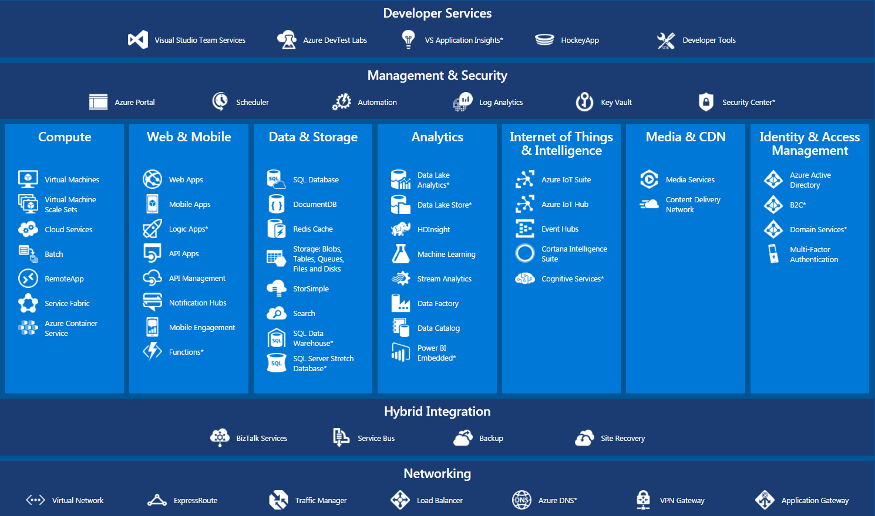
Azure Services Catalog

Slide 41
Conclusion
Agile Dev & Testing
Continuous integration
Automated Provisioning
Continuous Delivery
Repository & Collaboration
Continuous Feedback
Agile with Confidence
Azure Dev/Test
Azure PaaS Services (Web Apps/IaaS/Storage)
Infra as Code (Azure ARM Templates)
Visual Studio online/TFS
Application Insights

Slide 42
Key Takeaways
Cloud is an Agile Accelerator
Enables Business Agility
Reducing IT Costs
Improving Customer Experiences
Growing the Economy

Slide 43
What you can do to take action now.

Slide 44
Q & A

Slide 45
Title Slide Title - Agile Narrow (size 48) Contact - Calibri (size 13.5) Following Slides Title – Agile Narrow (size 40) Following Text – Calibri (size 13.5)

